Slide 2
BAHRIA UNIVERSITY
Health Insurance Scheme Orientation Brief

Slide 3
Flow of the Presentation
Introduction
Registration Process
Benefit / Description Plan (Entitlement limits)
Benefit Utilization Procedures
OPD Medical Claims
IPD & Maternity Medical Claims
Value added Services (discounts center / labs)
Exclusions

Slide 4
Introduction

Slide 5
INTRODUCTION
BU always take special interest in the welfare of its employees and in the same spirit, health of personnel is one of its main priority
Healthcare Insurance scheme provides compensation for expenditures incurred by BU employees (including spouses and children) on the treatment of diseases / ailments
BU is contributing almost 50 % of healthcare premium. Rest is collected from employees.
Current contract was awarded to M/S Jubilee General Insurance Co on the basis of BU Campuses satisfactory feedback.

Slide 6
INTRODUCTION
Health insurance scheme is administered/ managed by BU Head office Director Admin (Safety & Security).
Campuses / Constituent units have dedicated Officer In-charges Healthcare to administer /manage the scheme.
Employees are insured under two categories
Cat B - Group 8 – 13 including Faculty Members
Cat C - Group 1 - 7
Health insurance coverage is mandatory for all faculty members, officers and administrative staff of Bahria University. Fixed salary employees (TA/RA's) are not covered in the insurance scheme. However, it is optional for ex- armed forces officers.

Slide 7
Registration Process

Slide 8
Registration Process
Properly filled declaration form along with relevant documents of the newly inducted person / any addition (Spouse / Children) should be forwarded by the Campuses /Constituent Units to BUHO through weekly Email for registration with the Insurance Company. Scanned documents required are:
For Newly Inducted Employees:
i. | JGI Registration Form (Can be downloaded from BU Website) Form
ii. | Attested copy of employee CNIC
iii. | Attested copy of spouse CNIC
iv. | NADRA marriage certificate
v. | NADRA family registration certificate
vi. | Attested copy of Son CNIC age less then 25 years
vii. | Attested copy of daughter CNIC till unmarried
viii. | NADRA Children registration certificate less than 18 years
ix. | NADRA divorce certificate in case of divorce
x. | Copy of BU appointment letter
xi. | Photographs 1x1’’ ( in blue background)
Xii. | Alfalah Bank IBAN # must be filled in attached form for online reimbursement

Slide 9
Registration Process
For addition of newly married spouse / new born baby of insured employees:
Insurance company will issue health card to all employees after registration. This card will be used by the employee to avail health care in panel hospitals approved by the Insurance Company.
It is compulsory for all BU employees.
Earliest Registration of BU Employees is paramount.
i. | JGI Registration Form
ii. | JGI Medical Card copy
iii. | Attested CNIC copies of employee and spouse
iv. | NADRA marriage certificate
v. | Attested hospital birth certificate
vi. | NADRA Children registration certificate
vii. | Photographs 1x1’’ ( in blue background)

Slide 10
JGI HealthCare Mobile Application
JGI mobile application is available and may be downloaded by the employees. Instructions on Installation (Registration / Login) are as follows:
a. Download Jubilee Healthcare Insurance App from Play Store
b. Click on signup and enter Card number (as per JGI Health Insurance identification card issued to the employee i.e. 01-102422-01111.
c. Select gender
d. Enter mobile number and date of birth
e. Enter G-mail ID and password
Confirm password and click on signup
Registration process is complete, now log in

Slide 11
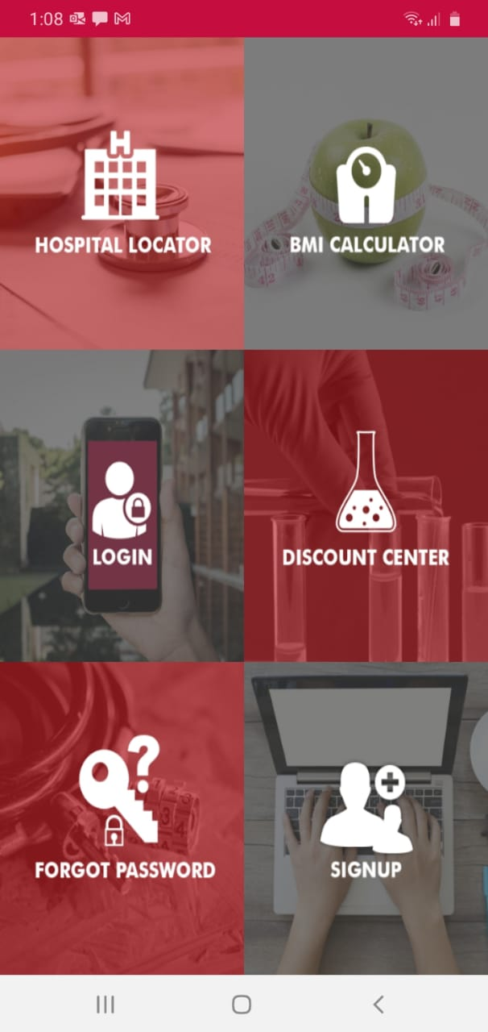
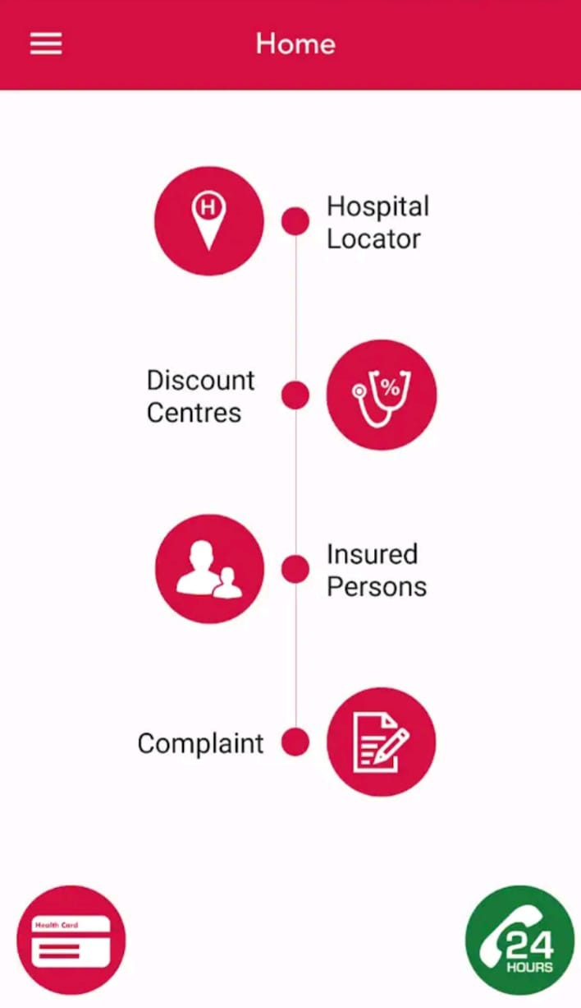
Medical card is displayed by pressing

Slide 12
JGI HealthCare Mobile Application
The key features of healthcare insurance application are:
Health Insurance card displayed.
Panel hospital location. (mobile location mode should be ON)
Discount centers (labs) location
Name of employee insured and dependents
IPD & OPD claim status (by clicking on employee name in insured person list)
Complaint (employee can write compliant against service provided)

Slide 13
Registration Process
PLEASE NOTE
In case of emergency before completion of registration process, employee may contact concerned Insurance office and get their Jubilee ID Number registered. The card becomes available in app immediately and is also acceptable at all panel hospitals.

Slide 14
Registration Process Age Limit
Insurance coverage | Remarks
Employee | Up to 65 years
Dependents
Spouse | 65 years
Children
Male | up to 25 years (unemployed and un married)
Female | till they get married
Life insurance (Death Compensation) | Until attaining age of 65 years.

Slide 15
Benefits / Description Plan

Slide 16
Benefits / Description Plan
BENEFITS DESCRIPTION/PLAN | CAT “B” (Group 8 to 13 including Faculty Members) | CAT “C” (Group 7 & Below)
DAILY ROOM CHARGES | Rs.12,000 | Rs.7,500
HOSPITAL EXPENSE BENEFITS (IPD): Total Hospital, Surgical & Misc. Expenses inclusive of Daily Room charges as per Annum per insured. | Rs.550,000 per family member | Rs.350,000 per family member
Per Hospitalization Pre Hospitalization Sub Limit (Diagnosis, consultation, & medicines) Pre Hospitalization Sub limit (Follow-Ups) (Before & After Hospitalization ) | 30 Days | 30 Days
Daycare Surgeries & Specialized Investigation in outpatient settings including but not Limited to: Dialysis, Cataract Surgery, MRI, CT Scan, Endoscopy, Thallium Scan, Angiography etc | Covered in Hospitalization limit (IPD)
Ambulance charges also Covered

Slide 17
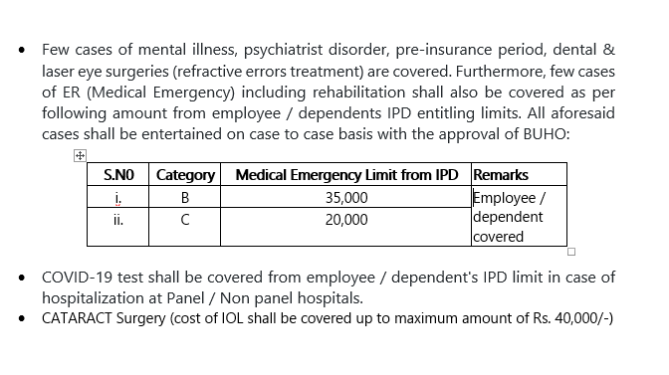
Benefits / Description Plan

Slide 18
Benefits / Description Plan
BENEFITS DESCRIPTION /PLAN | CAT “B” (Group 8 to 13 including Faculty Members) | CAT “C” (Group 7 & Below)
MATERNITY EXPENSE BENEFIT Normal Delivery C section | Rs. 93,000 Rs. 130,000 | Rs. 67,000 Rs. 97,000
OUT PATIENT EXPENSE BENEFIT (OPD) Total Annual OP limit For Married Employee For Single Employee | Rs.38,000 Rs.17,000 | Rs.20,000 Rs.12,000
Group Takaful Death Compensation / Disability Benefits | As per Policy
Normal | Rs.1,300,000 | Rs.1,000,000
Accidental | Rs.2,600,000 | Rs.2,000,000

Slide 19
Benefit Utilization Procedures

Slide 20
OPD Medical Claim
OPD claim, is a type of medical treatment that does not necessitate that the patient get hospitalized. Documents required for reimbursement are appended below:
i. | Dully completed OPD Claim form ( Can be downloaded from BU Website)
ii. | Doctor / consultant / prescription on letter head (Photocopy acceptable)
iii. | Proper Original Consultation charges receipt containing Bill No.by Doctor/ physician
iv. | Medicine receipt/ charges (original) of pharmacy/ medical store, etc (showing name of drug & quantity)
v. | Original receipts/ bills of diagnostic centers, laboratories, medical centres for lab test and x-rays, etc
vi. | Copy of diagnosis reports with supporting prescriptions

Slide 21
Common Observations in OPD Claims
Submission of medical claim after 2 months.
Missing of doctor prescriptions (Prescriptions must be written on hospital / doctor / Hakeem letterhead pad)
Missing of proper / itemized doctor / hospital bill (If any doctor / Hakeem write their consultation and medicines charges on their prescription, that is not acceptable. Separate / proper original bill of consultation / medicines having S.No. sign / stamp is compulsory.)
Missing of proper / itemized medical store bill. The bill must have S.No. and stamp.
Attaching of photocopy of bill with Medical claim.
Claiming specialized test expenses on OPD form rather than in IPD form.
When patient is not registered in Health Insurance Scheme during the period of getting treatment (Claim pertained to Pre-Insurance Period).

Slide 22
IPD & Maternity Medical Claim
IPD claim, is a type of medical treatment that does necessitate that the patient get hospitalized for minimum 24 hours.
Maternity insurance covers the expenses for normal and caesarean deliveries up to the sum insured
There are two ways to availed IPD & Maternity benefits:
Hospitalization at panel Hospital (list can be download from BU Website)
Hospitalization at Non-panel Hospital

Slide 23
IPD & Maternity Medical Claim
Procedure for Hospitalization at Panel Hospital
Step1: Initially patient consult Doctor by paying consultation fee
Step 2: If doctor advise for medical tests prior admission. Initially the employee pay expenses of medical tests. The consultation fee and medical test expenses will be reimbursed by JGI by submitting medical claim to insurance office.
Step 3: If Doctor advise hospitalization, employee show his medical card (Physical Medical Card / Jubilee App Medical card) alongwith doctor admission prescriptions at hospital counter. The hospital generate Email to Insurance Company for approval.
Step 4: All billing within authorized limit shall be taken by hospital directly with JGI

Slide 24
Non Panel IPD & Maternity Medical Claim
Hospitalization at Non-panel Hospital
Step 1: Pay for all authorized treatments at the hospital
Step 2: Submit claim with Insurance Office alongwith following documents for reimbursement within 2 months:
Documents required for IPD reimbursement
i. Dully completed IPD Claim form ( Can be downloaded from BU Website)
ii. Doctor prescriptions of tests / medicines on letter head.
iii. Medical reports related to the disease i.e. X-ray, ultrasound, birth certificate (must in Maternity case), etc. with supporting prescriptions before and after 30 days of admission
iii. Itemized hospital bill with breakup of expenses (photocopy and duplicate bill is not acceptable) / Detail breakup of amount required

Slide 25
PLEASE NOTE
PRE & POST HOSPITALIZATION EXPENSES
Expenses incurred on consultations, reports and medicines BEFORE and AFTER 30 days of discharge from hospital (panel & Non Panel) can be reimbursed from balance IPD Limit subject to availability. Employee can check balance IPD limit through jubilee mobile app.
PRE & POST NATAL EXPENSES
Pre- and post-natal expenses would mean costs pertaining to ultrasound, regular checkups, doctor's consultation fee, medicines and so on of maternity cases covered from the start of pregnancy period. Moreover, in case of medical expenses on new born baby, immediately ask panel hospital to generate e mail for new born baby treatment approval from JGI.
Lower Staff is advised to avoid medical treatment from expensive hospitals i.e. Shifa International, Maroof Hospital etc
Required Documents = IPD Form + Hospital Discharge Summary + All doctors prescriptions + proper Original consultation / medicine bills.
Please

Slide 26
Specialized Investigation
This includes benefits to cover cost incurred on specialized investigations from IPD entitlement on recommendation of a specialist only, which does not require hospitalization for 24 Hours
Scopes
• Gastroscopy
• Endoscopy
• Bronchoscopy
• Colonoscopy
Scans
• MRI / MRA & MRV
• CT scan
• Thyroid scan
• Renal scan
• Thallium scan
• PET scan
• Bone scan (only for cancer pts)
• Barium Meal
• Barium Swallow
• Barium Enema
Continue

Slide 27
Specialized Investigation
Conduction Studies
• NCS/EMG
• EEG
Graphic Studies
• Coronary Angiography
• Mammography
ETT / Echo/ EEG / EMG
PCR
ERCP ( Endoscopic retrograde cholangio – pancreatography)
Nuclear Scans
Holter Monitoring ϖ
Echo/Stress Echo
All types of Biopsies
OCT
FFA
COVID -19 test
Required Documents = IPD Form + Doctor prescriptions+ Report + original receipts

Slide 28
Daycare Surgery Expenses
Charges incurred for surgical operations without an overnight stay in a panel / non panel hospitals shall be covered from IPD (In-Patient) limit:
Painful/infected In grown toe nail (IGTN)
Infected cases (Abscess/cyst) Incision / drainage
Painful Lipoma (Cosmetic removal is not covered)
Painful Planter warts
Carpel Tunnel Syndrome Surgery/ daycare orthopedic procedures such as POP Back slabs
Cubital Tunnel Syndrome Surgery
Cataract Surgery (Cost of IOL shall be covered up to maximum amount of Rs.40,000/-
Injection Lucentis
All medically necessary eye procedures under LA, e.g. Pterygium (blurring vision), Nasolacrimal duct blockage,
Chalazion, painful internal, external hordeolum etc.
Continue

Slide 29
Daycare Surgery Expenses
Any eye disorder leading towards vision impairment e.g. retinal detachment, Periretinal membrane ,Keratoconus
Painful Sebaceous Cyst
USG guided Abscess drainage/Biopsy
Painful Ganglion
Endoscopic Ultrasound procedure
Dialysis
RFA Procedure ( Radio Frequency Ablation , for abnormal electrical conductivity of Heart)
Lithotripsy (for Kidney Stones)
Chemotherapy
Radiotherapy
ENT: Operation of the ear
ENT: Procedures on the nose & the nasal sinuses
ENT: Procedures on the tonsils & adenoids
Ophthalmology: Procedures on the eyes
Procedure on the tongue

Slide 30
Daycare Surgery Expenses
Procedures on the salivary glands & salivary ducts
Procedures on the mouth & face.
Trauma surgery and orthopedics
Procedures on the breast
Procedures on the digestive tract
Procedures on the urinary system.
Procedures of respiratory System
Procedures of Heart and Blood vessels
Accidental Cases
Cataract Surgery
Percutaneous Coronary Intervention
Documents required for IPD reimbursement
i. Dully completed IPD Claim form ( Can be downloaded from BU Website)
ii. Doctor prescriptions of tests / medicines on letter head.
iii. Medical reports related to the disease
iii. Itemized hospital bill with breakup of expenses

Slide 31
Common Observations in IPD/maternity Claims
When employee does not submit their medical claim within 2 months.
Missing of doctor prescriptions before and after the discharged from hospitals.
Missing of proper / itemized doctor / hospital original bill with breakup of expenses having S.No. sign / stamp is acceptable.
Missing of proper / itemized medical store bill. The bill must have S.No. and stamp
Discharged directly from emergency less then 24 Hours shall be reimbursed from OPD except specialized tests/surgeries.
When employee claim treatment that are not covered under the policy i.e. infertility, cosmetics etc. Exclusions will be discussed later.
Medical claim for the period He / She alongwith their dependents were not registered with Insurance company (Claim pertaining to Pre-Insurance Period)
Continue

Slide 32
Common Observations in IPD/maternity Claims
Entire Non Panel IPD / Maternity Medical Claim coverage depends on the room rent limit. (Category B room limit 12000 per day and Category C room limit Rs.7500/- per day)
What will happen if you choose or forced to choose higher than this room limit?
Proportionate deduction clause in health insurance policy will allow the JGI to deduct proportionate amount in all associated treatment charges in the same ratio of room rent limit exceeded. This is better explained with an example.
Suppose, you choose a room rent of Rs. 4,000/- per day, against a limit of Rs.3000/- per day as per your policy, then usually all the treatment charges (Doctor Fees, OT Charges etc) are also considered to be associated with the room rent charges. So, if your overall treatment bill is Rs.1,00,000/-, the claim settlement is expected to be approximately Rs.75,000/- after proportionate deduction. If your room rent limit is Rs.4,000/-, there won’t be any deductions on the associated treatment charges.
Employees are advised to get treatment from Insurance Company panel hospitals to avoid deduction and advance payment issues.

Slide 33
Value Added Services (Discount at labs / diagnostic centers)
Value Added Services (Discount Centers). JGI Company makes the employee eligible for a number of discount at various designated outlets all over Pakistan where employees enjoy savings on the following services:
Consultations
Labs
Diagnostics
List of Discount Centers can be downloaded from BU Websites.
Major Benefit:
Employees can save their OPD limits.

Slide 34
Value Added Services (Discount at labs / diagnostic centers)
S.No | Medical Centre Name | City | Discounts % | Discount on Facility
1 | Excel Labs, F-10 Point | Islamabad | 20% | Labs
2 | Excel Labs, F-8 Point | Islamabad | 20% | Labs
3 | Excel Labs, I-10 Point | Islamabad | 20% | Labs
4 | Excel Labs, I-8 Point | Islamabad | 20% | Labs
5 | Excel Labs, Blue Area | Islamabad | 20% | Labs
6 | Islamabad Diagnostics center | Islamabad | 15 % to 20% | Labs, Diagnostics, Pharmacy
7 | Quaid E Azam International Hospital | Islamabad | 10 to 25% | Labs
8 | Shifa International Hospital | Rawalpindi | 10% | Labs
Continue

Slide 35
Value Added Services (Discount at labs / diagnostic centers)
S.No | Medical Centre Name | City | Discounts % | Discount on Facility
9 | Excel Labs, Chaklala Scheem lll Point | Rawalpindi | 20% | Labs
10 | Excel Labs, GT Road Point | Rawalpindi | 20% | Labs
11 | Excel Labs, Sadiqabad Point | Rawalpindi | 20% | Labs
12 | Excel Labs, Saidpur Road Point | Rawalpindi | 20% | Labs

Slide 36
Exclusions

Slide 37
Exclusions
The policy comes with certain exclusions and accordingly expenses arising out of, but not limited to, the following are excluded.
Any treatment not recommended by a legally licensed Physician or which is not medically necessary.
Routine physical check-ups, rest cures.
Treatment of mental illness, psychiatric disorders, self-inflicted injury, suicide, abuse of alcohol, drug addiction or its abuse.
Cost of limbs of any other organ (prostheses) or any kind of supporting equipment for revival or correction of the function of body.
Treatment of any refractive errors of the eyes including cost of procedures such as 'Radial Keratotomy ' and ' Excimer Laser‘. Treatment of Obesity, weight reduction/enhancement.

Slide 38
Exclusions
Cosmetic/plastic surgery, unless medically necessitated due to accidental injuries occurring while the Insured was covered under the scheme.
Treatment or surgical operation for congenital defects or deformities, including physical and mental defects present from birth.
Treatment of infertility, impotency, sterilization & contraception including any complication relating hereto.
Any increase in the expenses incurred for the treatment on account of the Insured being admitted to a more expensive room than allowed by his/her daily room rent limit.
Sexually transmitted disease and any treatment or test in connection with Acquired Immune Deficiency Syndrome (AIDS) or any AIDS related conditions or diseases.

Slide 39
Health Insurance Query
JGI Help line:
a. M/s JGI Margalla Branch Islamabad:
i. Head Operations (Mr Arshad Shaikh): 0333-5152755
ii. Asst Vice President (Mr Shehzad): 0300-9501859
iii. Office No 051- 2828514-5
b. M/s JGI hotline: 021- 35657885-6
c. Healthcare office, BUHO: 051-9260002 Ext 1342
Health care Operations: 0331-5116401
subject to registration with insurance company and issuance of health card.

Slide 40
Recent Improvements
In order to reduce time delays in health insurance procedures/ processes, following measures have been recently introduced by BUHO Admin Dte:
a. All Campuses have been directed to send weekly registration data online
b. Submission of claims to be made directly to JGI by the Campuses. (Work in progress)
c. Claims reimbursement has been made online directly into the bank accounts of individual employees. So far 300 claims settled online.

Slide 41
Any Question

Slide 42
Any Suggestions /Feedback

Slide 43
Thank You

Slide 44
Out-Patient Benefits
Outpatient Benefits. provides coverage against following:
Registered General Medical Practitioner, Homeopathic physician/ Hakeem, specialist’s consultation
Prescription drugs (medicines and treatments including surgical dressings, physiotherapy and acupuncture)
Laboratory and X-ray examinations
ECGs and EEGs
Eye testing
Physiotherapy and other similar treatments
Ultrasound and other diagnostic tests
Dental treatment excluding orthodontics and all cosmetics treatment (braces, scaling, crowning, and dentures)

Slide 45
Hospitalization Expenses Benefits
Hospitalization Expenses Benefits (IPD) – Insurance company shall pay for all medically necessary treatment provided on the advice of physician during hospital confinement. Benefits include:
Daily room charges
Hospital miscellaneous expenses -Expenses made for prescribed medical supplies & services, baby nursing care, physicians & surgeons’ visits, laboratory tests & X-Ray examinations, operation theatre charges, anesthesia & administration there of, blood transfusion including cost of blood, ICU, circumcision charges
Surgical Expenses - Fee for any surgical operation. Fee for any surgical operation performed by a Licensed Physician / Surgeon
Congenital - Congenital diseases of new born children are covered
Hepatitis - covered as In-Patient without admission in hospital

Slide 46
Hospitalization Expenses Benefits
MATERNITY Any hospitalization directly or indirectly related to pregnancy is governed by the maternity benefit: (1) Pre and post natal expenses. (2) Gynecologist’s fee. (3) Labor Room & Operation theatre charges. (4) Anesthetist fee. (5) Medicines. (6) Diagnostic tests. (7) Baby Nursing care. (8) Circumcision of a baby boy. (9) Cesarean Section and Complicated Deliveries/ Pregnancies by and on recommendation of specialist only.

Slide 47
Dread Diseases Expenses Benefits
Following expenses are covered:
Myocardial infarction (Heart Attack).
Coronary Artery Disease requiring surgery.
Management of all types of Malignant diseases(Cancer).
(4) Stroke producing neurological sequelae lasting.
Management of Renal Failure (Kidney Failure).
Renal and other major organ transplantation.
Severe burns.
(8) Multiple sclerosis.

Slide 48
Dread Diseases Expenses Benefits
9) Aids complex. (10) Chronic Hepatitis “B” & “C”. (11) Coronary Angioplasty. (12) Organ failure ( with out Transplantation): Blood purification process like peritoneal dialysis or hemo- dialysis, chemotherapy and radio therapy is also covered. (13) Liver cirrhosis (Gradually widespread death of liver cells). (14) Meningitis (inflammation of meningitis of brain) Bacteria, viruses, drugs and other organism may cause it. (15) Brain Tumor: This comprises of the treatment either through chemotherapy, radio therapy or open surgery for all brain tumors.

Slide 49
Dread Diseases Expenses Benefits
(16) Rheumatic Heart Diseases. (17) Parkinson’s Disease (18) Muscular Dystrophy (19) Alzheimer's Disease (20) Myasthenia Gravis (21) Syringomyelia (22) Motor Neuron Disease (23) Pulmonary Embolism (24) Paralysis

